Slide 1
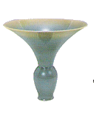
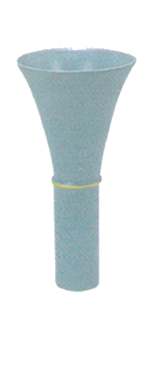
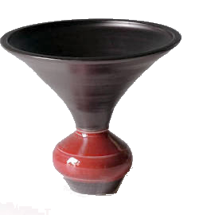
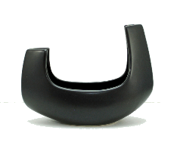
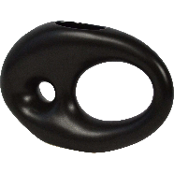
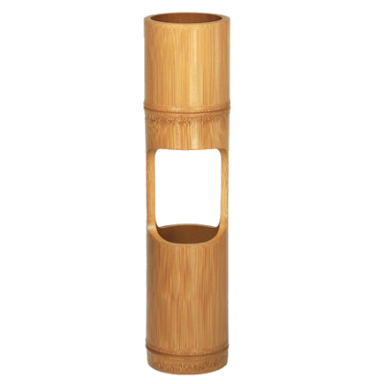
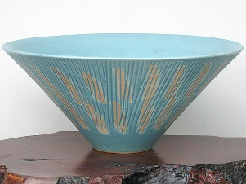
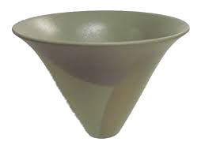
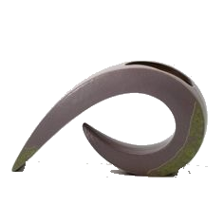
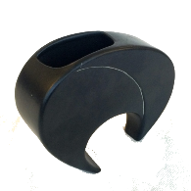
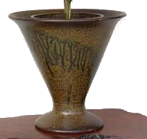
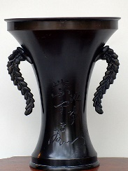
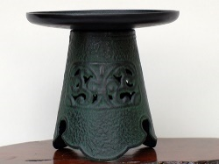
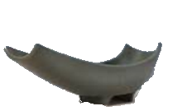
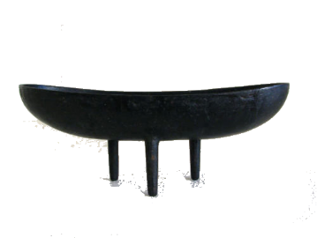
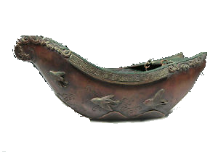
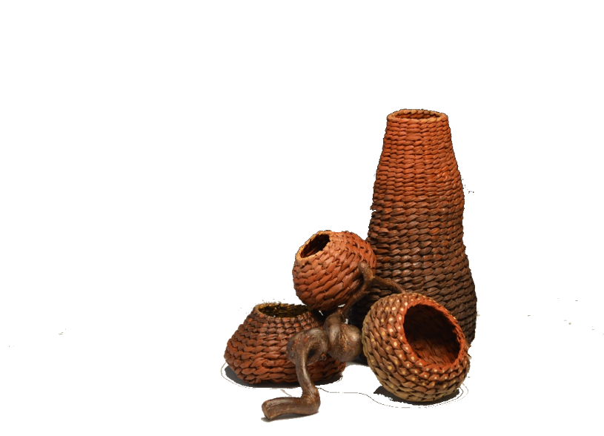
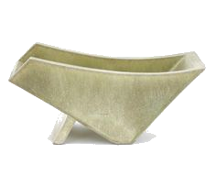
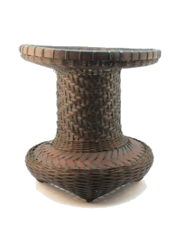
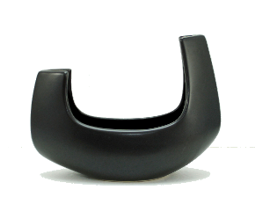
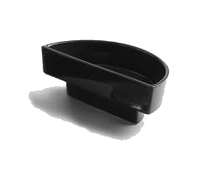
Container Types for Ikenobo Arrangements
Containers on the left are suitable for shoka arrangements including Isshuike, nishuike, sanshuike and shimputai. Also suitable for rikka and some jiyuka.
Containers for shoka and rikka should have an opening at the top that is wider than the base and the top edge should be completely even.
The containers below are all suitable for jiyuka style arrangements.
Boat containers are used for boat arrangements and can also be used in some shoka and jiyuka arrangements.
Bronze containers shown to the left are suitable for traditional rikka and Traditional shoka arrangements. Not suitable for modern rikka or sanshuike shoka, jiyuka or any shimputai.
These are suiban style containers and are suitable for futakabu-ike shoka, some modern shoka and classical rikka designs and Jiyuka..
Baskets are suitable for traditional isshuike and nishuike shoka designs. Not suitable for sanshuike, shimputai or futakabu-ike designs. Baskets without handles are preferable. Kenzan must be raised to just below the tip of the basket

